Slide 1


Financial Highlights
As of April 30, 2022

Slide 2

Highlights of Interim Financial Report (unaudited)
April 30, 2022
BUDGET AMENDMENT REPORT for the May 18, 2022
Board meeting
Click below for a 1-minute Briefing:
https://www.showme.com/sh?h=7E6vC9A
Prepared by: Business Support Services Division

Slide 3
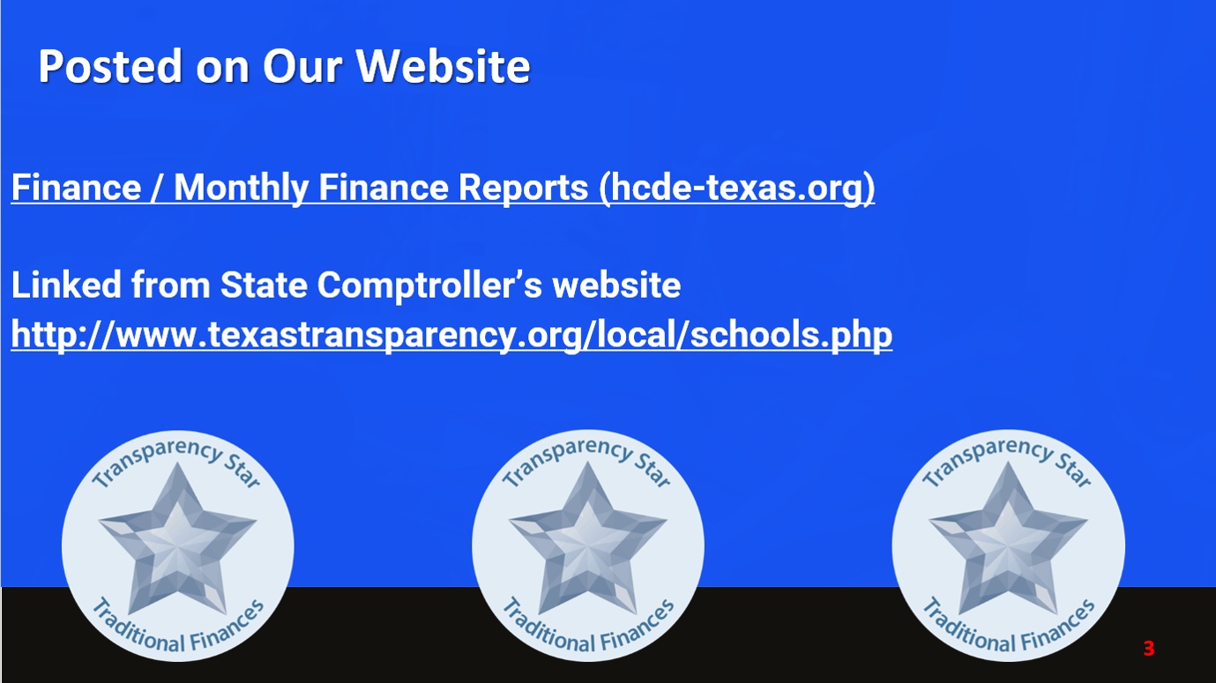
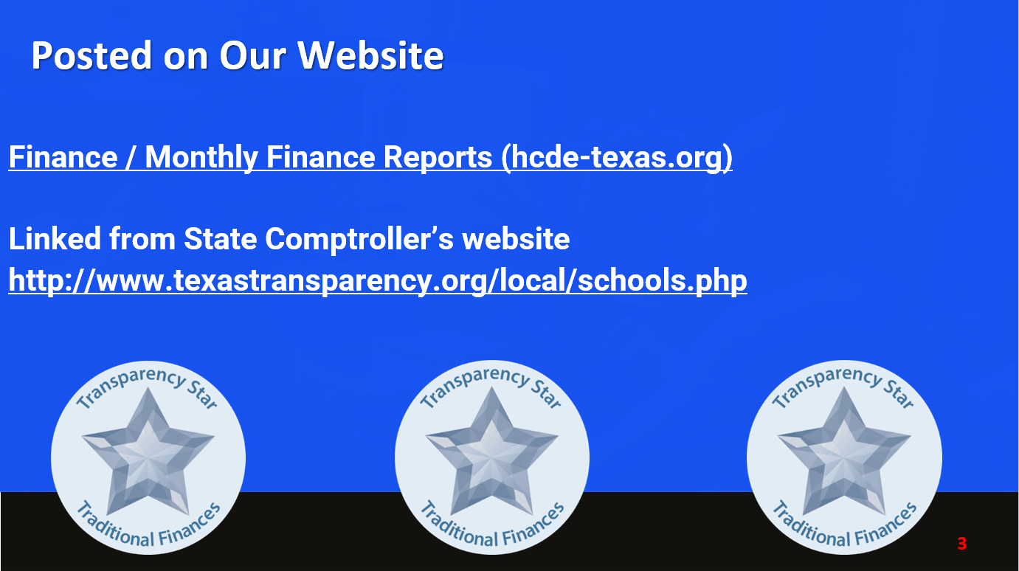



Posted on Our Website
Finance / Monthly Finance Reports (hcde-texas.org)
Linked from State Comptroller’s website
http://www.texastransparency.org/local/schools.php

Slide 4
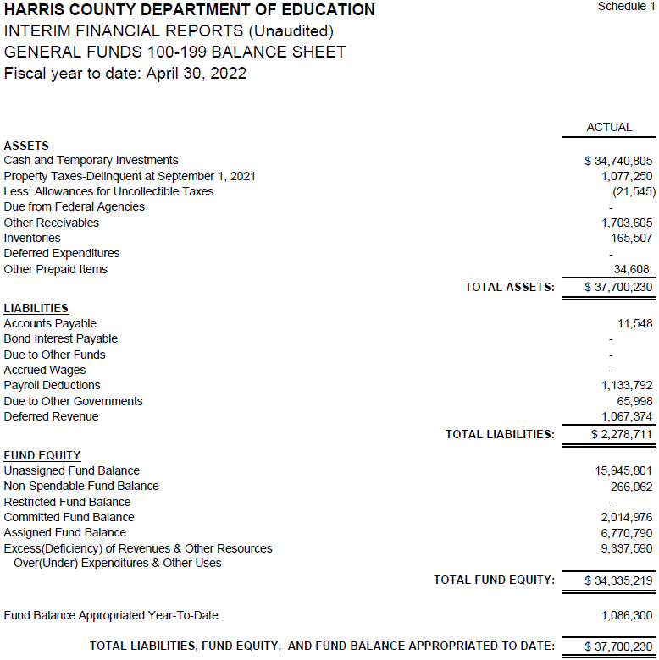

INTERIM FINANCIAL REPORT
(unaudited)
GENERAL FUND
Balance Sheet as of April 30, 2022
Total Assets:
$ 37,700,230
Total Liabilities:
$ 2,278,711

Slide 5
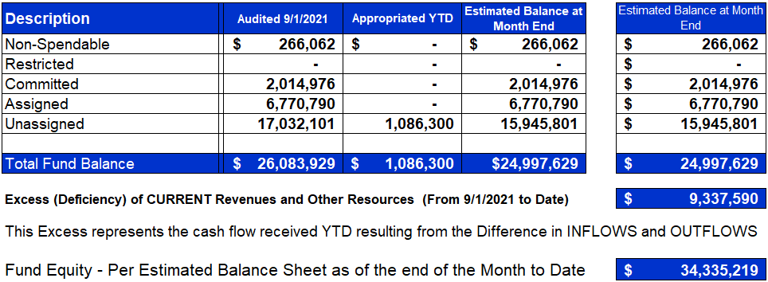
INTERIM FINANCIAL REPORT (unaudited)
ASST. SUPERINTENDENT FOR BUSINESS SERVICES MESSAGE
As of April 30, 2022
The ESTIMATED General Fund balance at 04/30/2022 is $34,335,219 after current appropriations.
As year end adjustments are completed, a budget amendment will be submitted to the board for items assigned, restricted and committed that will roll forward into FY 2023.

Slide 6

INTERIM FINANCIAL REPORT (unaudited)
As of April 30, 2022
Financial Ratios
Level One - Indicator of Financial Strength
Level Two - Indicator of Efficient Leverage
Level Three - Indicators of Efficiency
Level Four - Indicators of Revenue Growth

Slide 7

INTERIM FINANCIAL REPORT (unaudited)
As of April 30, 2022
Indicators of Financial Strength
Percent of Fund Balance to G/F
Expenditures Ratio
What is the percent of rainy fund balance? (*)Unadjusted
Working Capital Ratio
What is the cash flow availability for the organization?
Unassigned Fund Balance $15,945,801
Total G/F Expenditures $35,384,908
Goal : > 30% of G/F Exp.
Benchmark: 10% to 29%
Danger: Under 10%
Goal : >$15,000,000
Benchmark : $10M to $15M
Danger : Under < $10M
Total Current Assets
Less Total Current Liabilities
$37,700,230– 2,278,711= 35,421,519
45% FY22
52% FY21
$35M FY22
$44M FY21
Budgeted 30%
Details on Schedule 3
Budgeted $33M
Details on Schedule 1

Slide 8
INTERIM FINANCIAL REPORT (unaudited)
As of April 30, 2022
Indicators of Efficient Leverage Reserves
Unassigned Fund Balance Ratio
How much is available in reserves?
Debt to Income Ratio
What is the ability of HCDE to cover its debt payments?
Unassigned Fund Balance $15,945,801
Total Fund Balance $35,421,519
Annual Principal and Interest Payments on
Term Debt and Capital Leases $ 3,532,411
G/F Revenue Less Facility Charges
44,443,095 - 3,711,995
Goal: <75%
Benchmark: 50% to 75%
Danger: <50%
Goal: <25% of annual revenue
Benchmark: 25% to <49%
Danger: Over > 50%
45% FY22
39% FY21
8.7% FY22
8.0% FY21
Budgeted 87%
Details on Schedule 1
Budgeted 6%
Details on Schedule 5

Slide 9
INTERIM FINANCIAL REPORT (unaudited)
As of April 30, 2022
Indicators of Efficiency
Tax Revenue to Total Revenue Ratio
How efficient is HCDE at leveraging local
taxes? (Current)
Indirect Cost to Tax Ratio
How much dependency on indirect cost from grants?
Current Tax Revenue $25,049,122
Indirect Cost General Fund $1,172,749
Total Revenue $73,574,301
Total General Fund Revenues $44,722,499
Goal: <20% of revenue
Benchmark: 20% to 30%
Danger: Over >30%
Goal: >5%
Benchmark: 2% to 5%
Danger: Under < 2%
34% FY22
21% FY21
2% FY22
3% FY21
Budgeted 41%
Details on Schedule 2
Budgeted 3%
Details on Schedule 3

Slide 10
INTERIM FINANCIAL REPORT (unaudited)
As of April 30, 2022
Indicators of Revenue Growth
Fee for Service Revenue Ratio
How are revenues spread across all Funds?
Fee for Service Revenue Growth Ratio
What is the market growth for fee on services?
Total Fee for Service Revenues (G/F) $15,069,947
Total Revenues $73,294,897
Fee for Service Current Year Less Fee for Services Last Year $15,069,947 - 15,761,508
Fees for Service Last Year $15,761,508
Goal: >30% of annual revenue Benchmark: 10% to 29%
Danger: Under 10%
Goal: >3% of + growth
Benchmark: 0% to 3%
Danger: Under 0%
21% FY22
13% FY21
-4% FY22
-6% FY21
Budgeted 44%
Details on Schedule 14
Budgeted 4%
Details on Schedule 14

Slide 11
FY 2021-2022
Fund Balance
-
Budgeted Activity

Slide 12
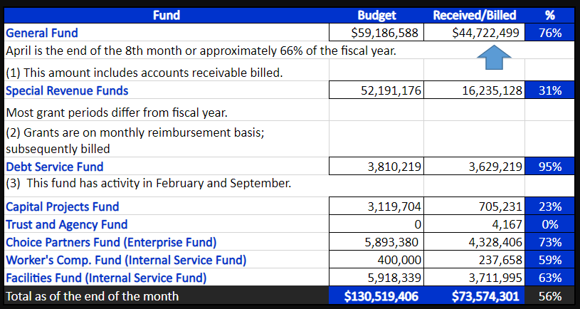
INTERIM FINANCIAL REPORT (unaudited)
GENERAL, SPECIAL REVENUE, DEBT SERVICE FUNDS, CAPITAL PROJECTS,
AND INTERNAL SERVICE FUNDS
REVENUES (INFLOWS)
Budget to Actual for period ending April 30, 2022

Slide 13
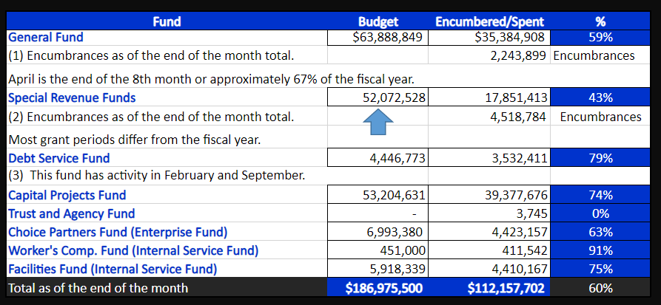
INTERIM FINANCIAL REPORT (unaudited)
GENERAL, SPECIAL REVENUE, DEBT SERVICE FUNDS, CAPITAL PROJECTS,
AND INTERNAL SERVICE FUNDS
Expenditures (OUTFLOWS)
Budget to Actual for period ending April 30, 2022

Slide 14
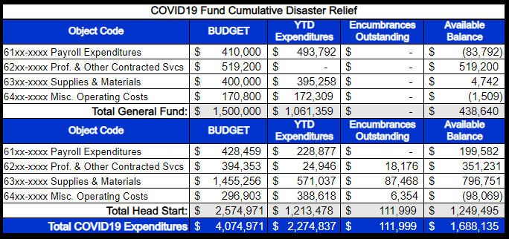
INTERIM FINANCIAL REPORT (unaudited) FY 2021&22 COVID19 Budget to Actual –
Expenditures
for period ending April 30, 2022

Slide 15
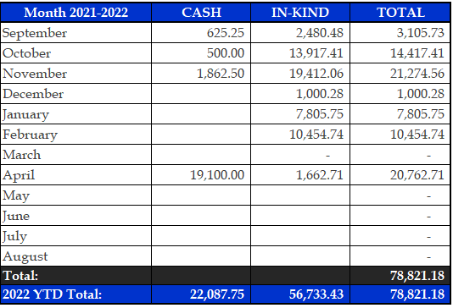
INTERIM FINANCIAL REPORT (unaudited)
FY 2021-22 Donations Report
All Funds as of April 30, 2022

Slide 16
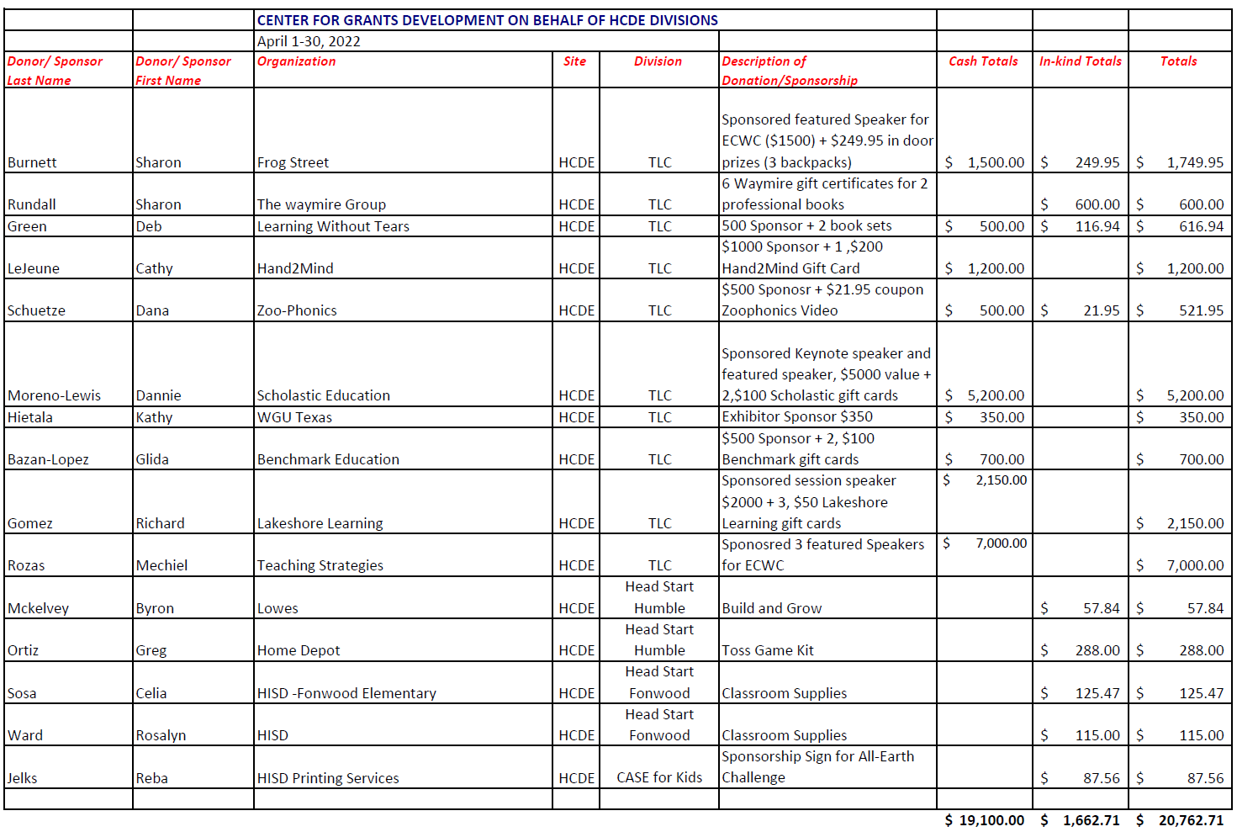
INTERIM FINANCIAL REPORT (unaudited)
FY 2021-22 Donations Report
All Funds as of April 30, 2022

Slide 17
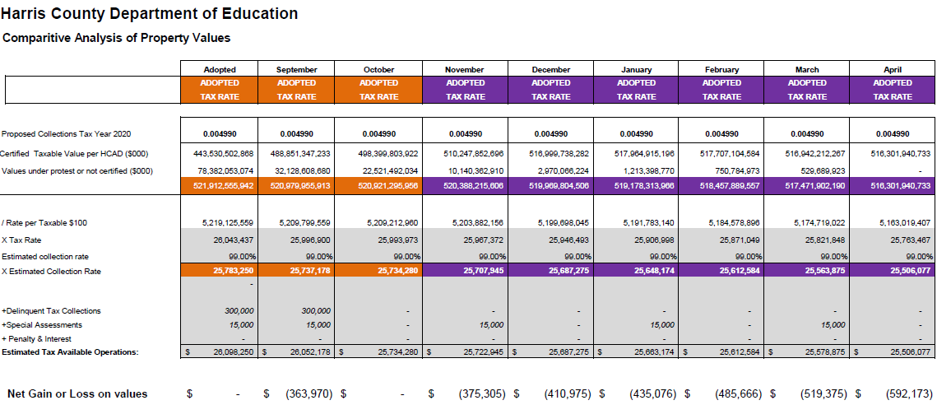
INTERIM FINANCIAL REPORT (unaudited)
TAX COLLECTIONS COMPARATIVE ANALYSIS
Fiscal Year-To-Date as of April 30, 2022
$516 B
See Tax Calculator at:
https://hcde-texas.org/transparency/tax-rate/
17

Slide 18
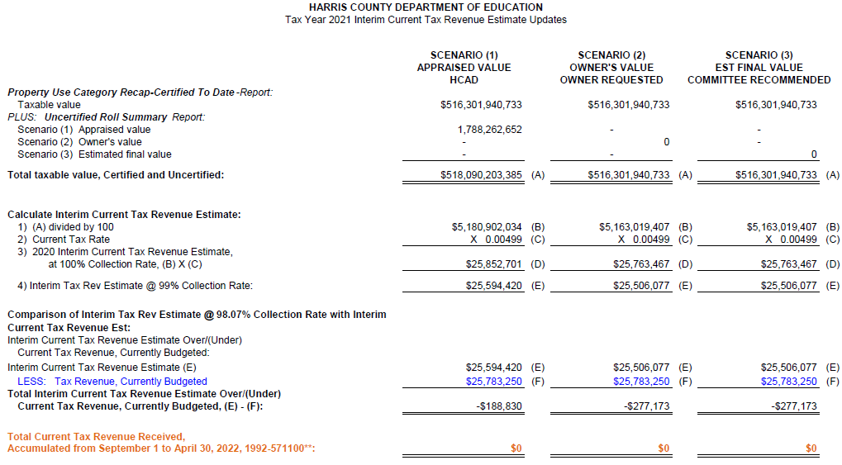
INTERIM FINANCIAL REPORT (unaudited) TAX COLLECTIONS
Fiscal Year-To-Date as of April 30, 2022
(8th month / 12 months)

Slide 19
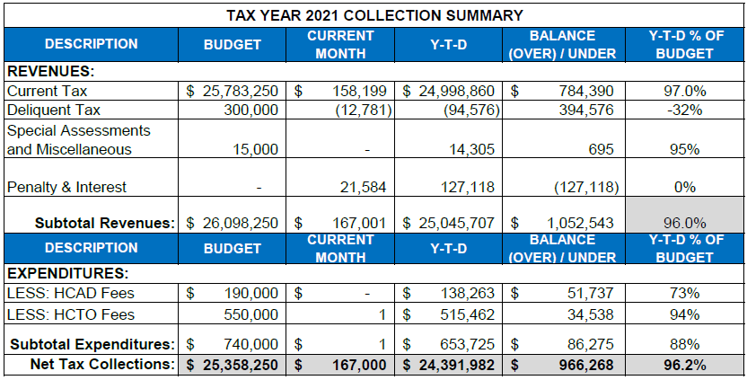
INTERIM FINANCIAL REPORT (unaudited) TAX COLLECTIONS
Fiscal Year-To-Date as of April 30, 2022
(8th month / 12 month)
a) 2021 Tax Rate = $0.004990/$100 Property Assessment/Appraisal - --> Annual Tax on a $249,978 - $67,494 = $182,484/100 x .004990 =
Residential Property = $9.11 (net of 27% homestead exception.)
b) $705,000/$25,188,000 = 2.80% Collection and assessment costs

Slide 20
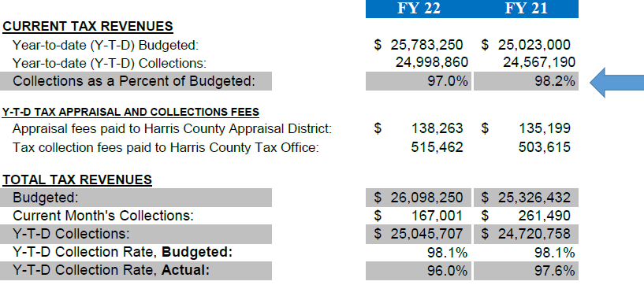
INTERIM FINANCIAL REPORT (unaudited) TAX COLLECTIONS
Fiscal Year-To-Date as of April 30, 2022
(8th month / 12 month)
a) 2021 Tax Rate = $0.004990/$100 Property Assessment/Appraisal - --> Annual Tax on a $249,978 - $67,494 = $182,484/100 x .004990 =
Residential Property = $9.11 (net of 27% homestead exception.)
b) $705,000/$25,188,000 = 2.80% Collection and assessment costs

Slide 21

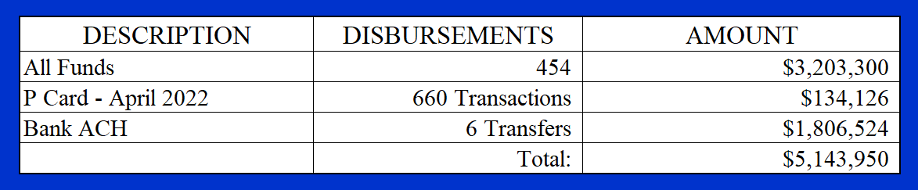
INTERIM FINANCIAL REPORT (unaudited)
DISBURSEMENT – ALL FUNDS
April 30, 2022
Notes:
All Purchase Orders and Payment Authorizations are reviewed before disbursement.
All Procurement Card charges are reviewed by cardholder, supervisor, and business office staff each month.
A report on CH Local Expenditures is included in the monthly report.

Slide 22
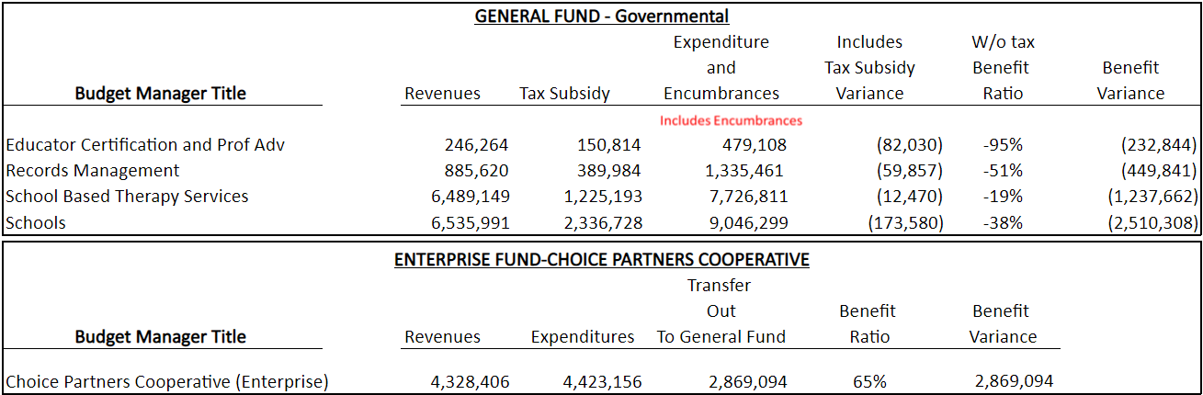
INTERIM FINANCIAL REPORT (unaudited)
Segment Division Data
As of April 30, 2022

Slide 23

Education Foundation Update
April 30, 2022

Slide 24
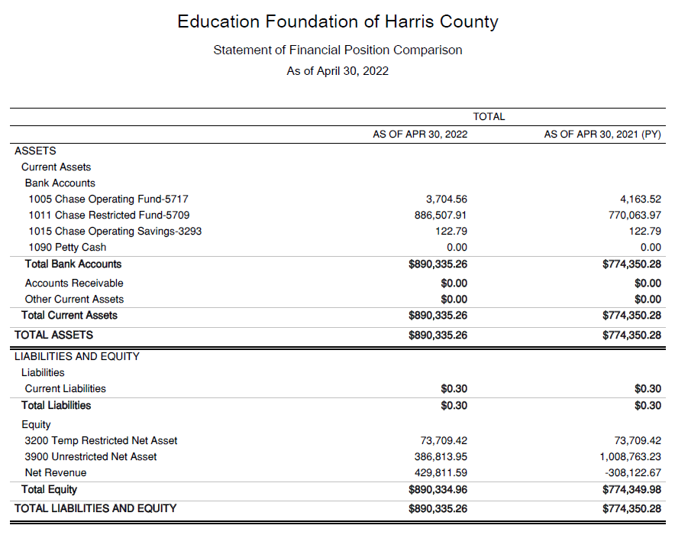
Statement of Financial Position
Net Equity $774,350.28

Slide 25
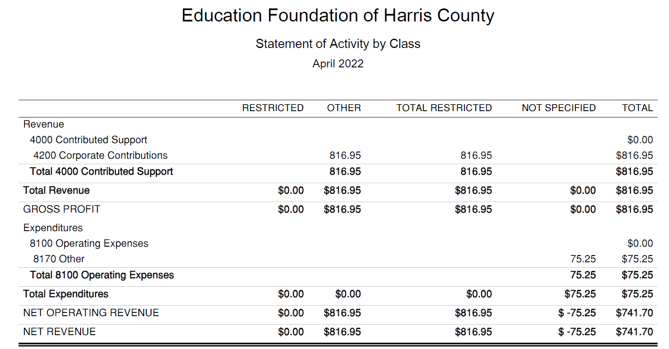
Statement of Activities Classified

Slide 26
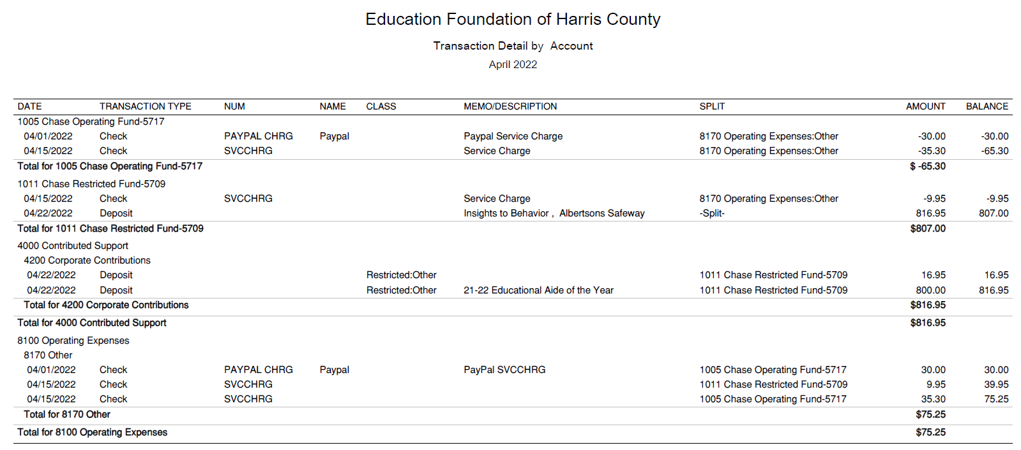




Transaction Detail by Inflow & Outflow

Slide 27
PFC & Lease Revenue Projects Update
April 30, 2022

Slide 28
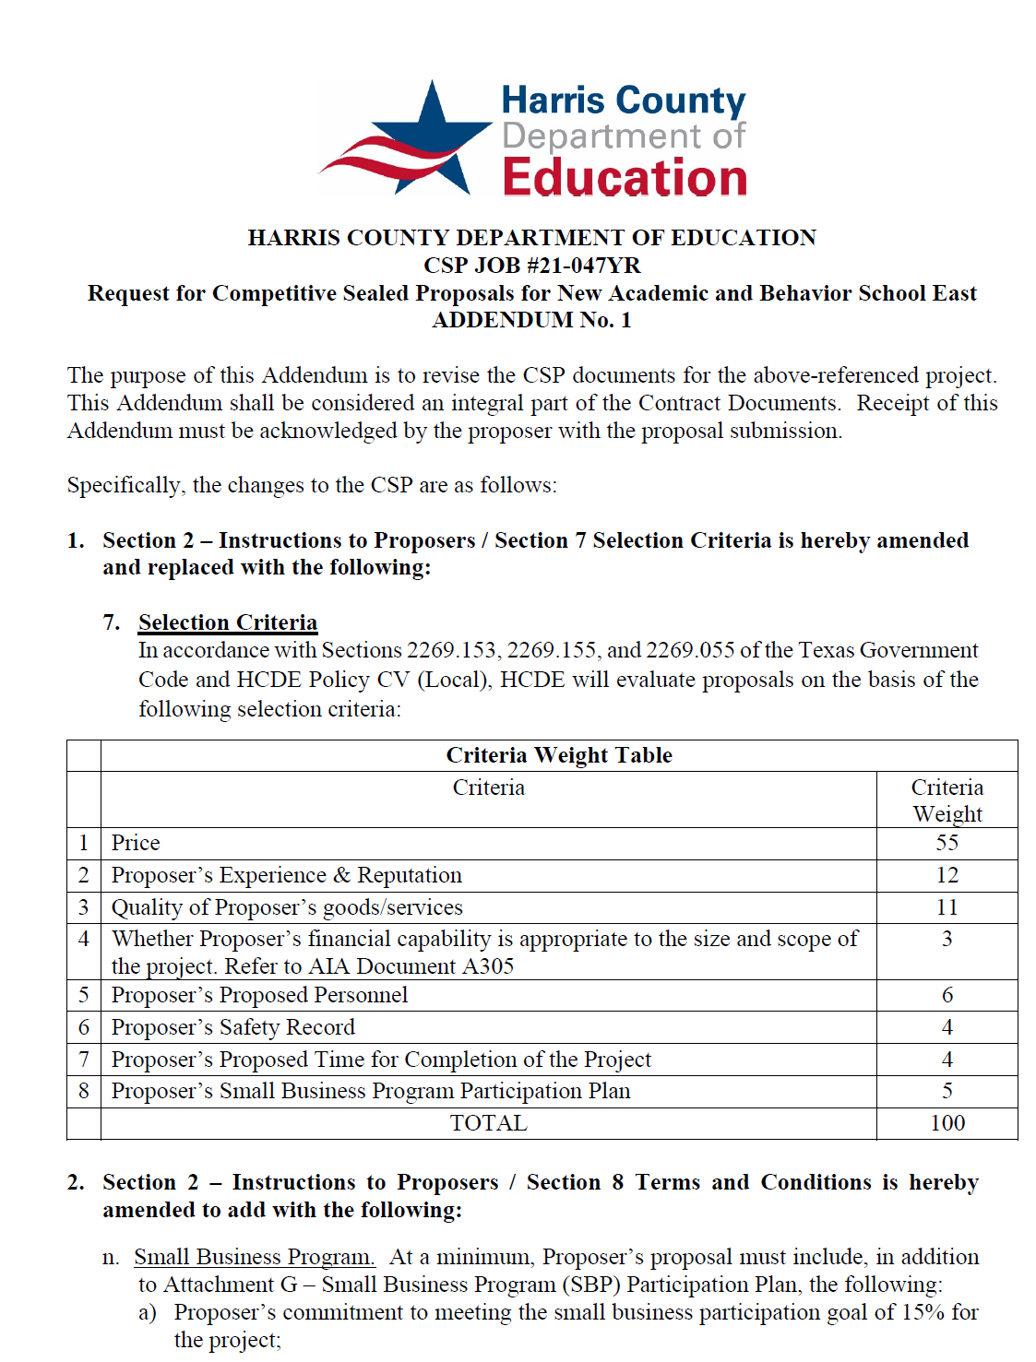
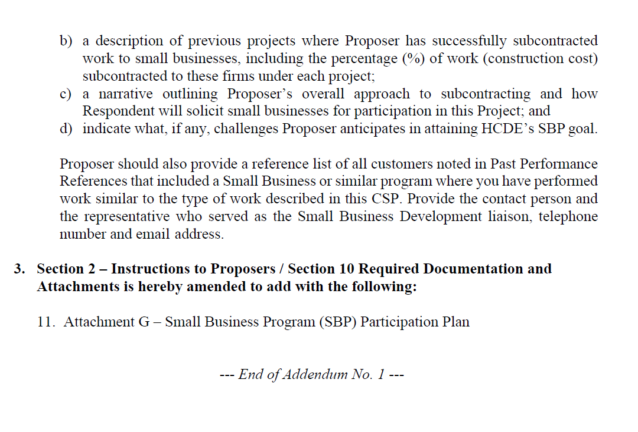
Small Business
Program for construction
Launch industry's first collaboration feature
This is our plan as we launch the industry's first collaboration feature

Slide 29
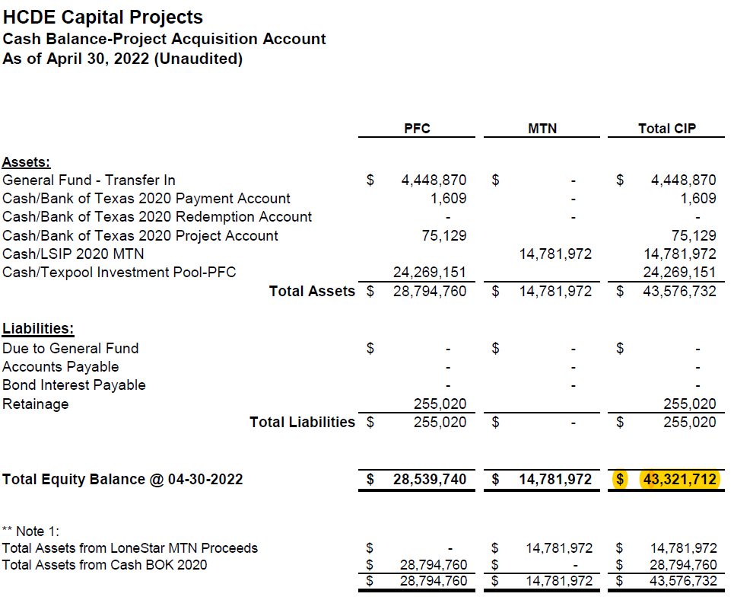
AB East School Contract $12,358,000 Awarded and Signed
Adult Ed Center Contract $15,121,000 awarded on Oct 2021 Board Mtg
HP East Contract $7,271,000 awarded on Nov 2021
Irvington – Pending Architect Assignment
Cash Balance –
Project Acquisition Account
As of April 30, 2022

Slide 30
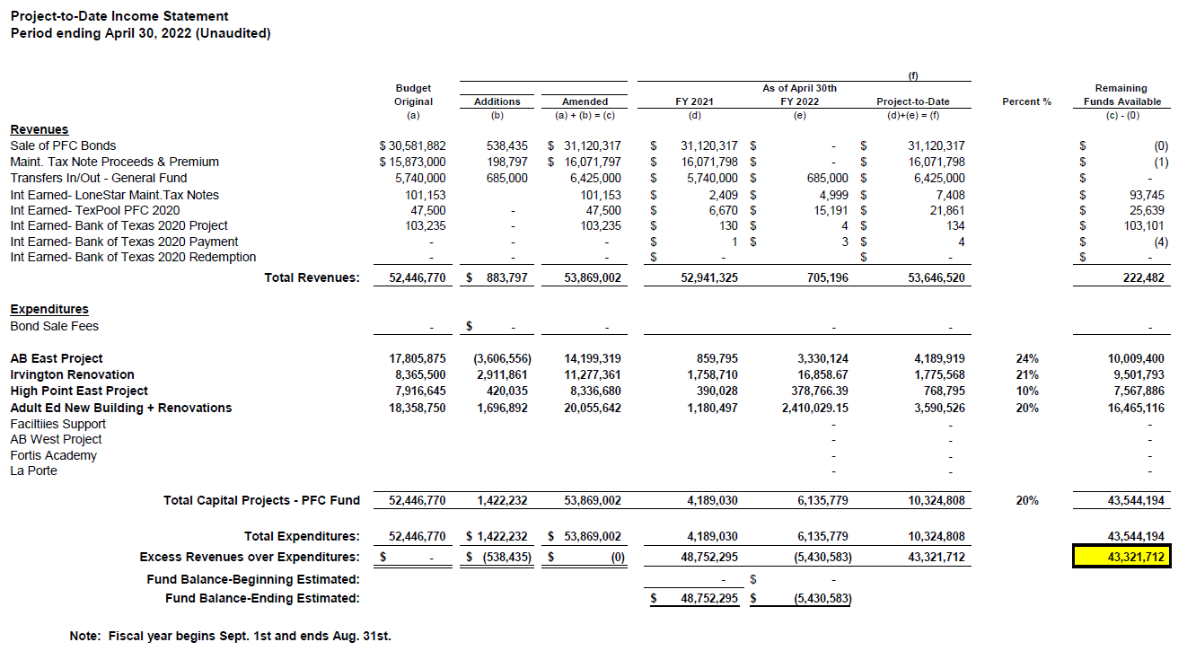
Income Statement– Project Acquisition Account
As of April 30, 2022

Slide 31

Capital Program Proposal from Aug 3, 2020

Slide 32






2020 Projected Capital Improvement Program
Project | Substantial Completion Date | Project Budget | Maintenance Notes Projected | Revenue Bonds Proceeds | General Funds Use of Fund Bal. | Interest Earnings Projection
Reagan Adm Bldg. | Feb 9, 2023 | $8,365,500 | $ 8,365,500 | N/A | N/A
Adult Ed Building | Oct 25, 2022 | $18,358,750 | $ 3,659,000 | $12,728,598 | $1,870,000 | $101,153
HP East Middle | Oct 25, 2022 | $7,916,645 | $ 1,089,500 | $4,909,645 | $1,870,000 | $47,500
Ab East Campus | Aug 16, 2022 | $17,805,875 | $ 2,759,000 | $12,943,640 | $2,000,000 | 103,235
 | Total | $52,446,770 | $15,873,000 | $30,581,882 | $5,740,000 | $251,888
 |  | Closed on 12-2-20 | Invested in pools.
Build a product accessible on all devices
This is our plan as we build a product accessible on all devices.
Note: The Total Public Notice was $54,000,000. ($35,000,000 for Revenue bonds and $19,000,000 for Maintenance Notes) on August 10, 2020. A transfer of $1,350,000 plus $50,000 in reimbursable expenditures was made from AB East to allocate Program Manager costs to establish the budgets.
Based on Pricing the principal amount will vary due to the premium projected in the bond sale. Revenues Bonds estimated at $27,730,000 and Maintenance Notes for $13,695,000

Slide 33


Interim Financial Report (Unaudited)
I certify that the foregoing information is true and accurate to the best of my knowledge.
/s/ Jesus J. Amezcua, RTSBA,CPA, Ph.D., CPFIM, Asst. Supt. for Business Support Services
/s/ Marcia Leiva, Chief Accounting Officer
/s/ Rubi Platero, MBA, Staff Accountant II

